Slide 1
10/24/22

Slide 2
A few notes on
Shakespeare

Slide 3
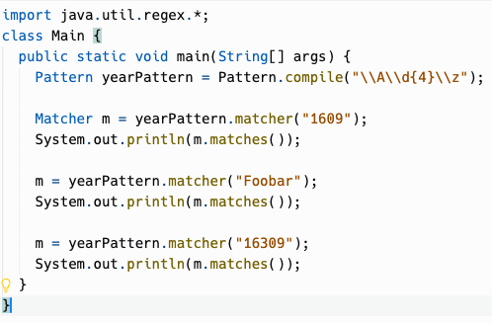
State Machines - Regular Expressions
START
\A\d{4}\z
Not a digit 0-9
WAIT_FOR_DIGIT_1
Received a digit 0-9
Not a digit 0-9
WAIT_FOR_DIGIT_2
Received a digit 0-9
Not a digit 0-9
WAIT_FOR_DIGIT_3
Received a digit 0-9
Not a digit 0-9
WAIT_FOR_DIGIT_4
Received a digit 0-9
Not EOF
WAIT_FOR_EOF
Received EOF
END - false
END - true

Slide 4
Unit 4 Review
Chapter 4.6

Slide 5
4.1
The while loop

Slide 6
Iteration
Iteration, in the context of computer programming, is a process wherein a set of instructions are repeated a specified number of times or until a condition is met.
Each time the set of instructions is executed is called an iteration.
Another term for iteration is loop… the program "loops back" to an earlier step and repeats.

Slide 7
while syntax
Flowchart of while
while (boolean expression)
statement
Does boolean expression evaluate to true?
Example:
Yes
int i = 1;
while (i <= 100) {
System.out.println(i);
i++;
}
No
Execute statement
It's like an if statement that keeps repeating itself.
Like if, we recommend curly braces always.
(But Java does not require it.)
Next statement after while

Slide 8
++ and -- operators
int i = 1;
while (i <= 100) {
System.out.println(i);
i++;
}
int i = 1;
while (i <= 100) {
System.out.println(i++);
}
void printManyTimes(String s, int count) { while (count > 0) {
System.out.println(s);
count-–;
} }
void printManyTimes(String s, int count) {
while (--count >= 0) {
System.out.println(text);
} }
i++ means post-increment, so it evaluates to the current value of i, then increments it. The increment/decrement is a side effect.
Opinions differ on style here.

Slide 9
= (assignment) can be used in the condition
Your loop condition may depend on some code that repeats every iteration:
String command = getNextCommand(); while (command != null) { executeCommand(command); command = getNextCommand();
} }
The assignment operator can be used in the condition to avoid the repetition:
String command; while ((command = getNextCommand()) != null) { executeCommand(command); } }
Programmers may differ on the style here. (The first style was used in Magpie.)

Slide 10
Sentinel values
A sentinel value is a special value that tells the loop to terminate.
The code from the previous slide is an example of this:
getNextCommand returns null when there are no more commands to execute.
String command;
while ((command = getNextCommand()) != null) {
executeCommand(command);
}
}

Slide 11
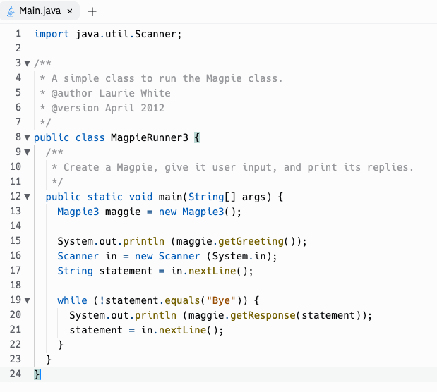
Input-controlled loops
The while loop is often used for input-controlled loops, where input is being taken from the user, or from a file on disk, or the network.
An example is the MagpieRunner, where the while loop continues until the user enters "Bye", the sentinel value which tells Magpie that no more input is coming and terminates the loop.

Slide 12
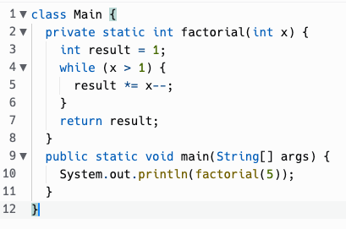
Tracing loops
x | result
5 | 1
4 | 5
3 | 20
2 | 60
1 | 120

Slide 13
do…while syntax
Flowchart of while
do
statement
while (boolean expression)
Execute statement
Sometimes, you want to check some condition AFTER the body of the loop has run, not before.
Does boolean expression evaluate to true?
Example:
String name; do {
System.out.println("Enter your name.");
name = scanner.nextLine();
} while (name.length() == 0);
Yes
No
Next statement after do…while

Slide 14
Infinite loops
void serveRequestsForever() {
while (true) {
handleNextRequest();
} }
This may seem strange, but it has its place.
Sometimes the loop isn't really infinite, but the termination condition of the loop is complicated.
There are ways to break out of a loop, even an infinite one (break, return).
There may also be unintentional infinite loops in your code that you need to fix!

Slide 15
4.2
The for loop

Slide 16
Counter-controlled loops
We looked at input controlled loops, which are often done using while.
For statements are often used to do counter-controlled loops, where the loop is repeated a specific number of times, and a numeric counter is used to track which iteration the loop is on.
However, really, any of the loop statements in Java can be used to write any possible program. Which loop to use is a matter of what you think best expresses the intent of the program.

Slide 17
for syntax
Flowchart of for
Evaluate initialization expression
for (initialization; condition; increment)
statement
Does condition evaluate to true?
Example:
Yes
int i;
for (i = 1; i <= 100; i++) {
System.out.println(i);
}
No
Execute body statement
Evaluate increment expression
Next statement after for

Slide 18
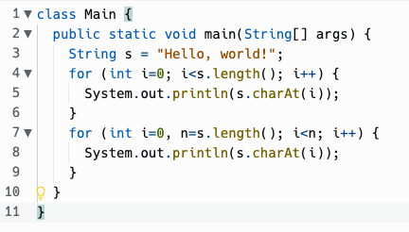
for syntax
for (initialization; condition; increment)
statement
initialization may also declare variables, even multiple variables (but only of the same type)
The scope of any variable declarations is purely the for loop itself.

Slide 19
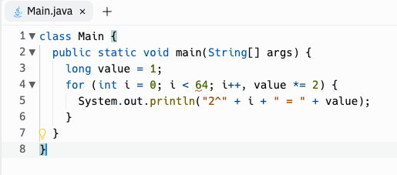
for syntax
The increment expression can use "," to update multiple variables.
And you're not limited to ++, --, although they are the most common things to see there.

Slide 20
for syntax
for (initialization; condition; increment)
statement
initialization, condition, and increment are all optional
for (;;) { … }
is an infinite loop, the same as while (true) { … }
Why would you omit initialization?
Sometimes the initialization needed takes multiple statements and can't be easily expressed in a single expression, so you do it before the for loop and omit the initialization.
Why would you omit increment?
Increment logic may similarly get complicated and be better expressed within the body of the loop.

Slide 21
for syntax
for (initialization; condition; increment)
statement
for statements are very frequently used with numeric counters, usually integers.
But they don't have to be… the expressions can be most anything.
// Cast spell to magically look east as far as possible.
for (Room room = player.getLocation();
room != null;
room = room.getEast()) { printRoomContents(room);
}
for is very flexible in this way.
Some languages like BASIC have a FOR statement that only can initialize and increment a numeric counter.

Slide 22
Getting out of a loop, or the current loop iteration
return
break
continue
You can exit a while or for loop by returning out of the enclosing method.
One student wrote this for the TruthGame pickNext method:
public int pickNext() { for (int i=1; i<=3; i++) { if (isTruth(i)) { return i; } } return -1; }
break exits a while or for loop and just moves on to the next statement after the loop.
while (true) { String command = scanner.nextLine(); if (command.equals("quit")) { break; } … } System.out.println("Well, goodbye, then!");
continue jumps back to the top of the loop and re-evaluates the condition. It's useful for skipping the body of the loop, like to ignore blank lines.
while (scanner.hasNextLine()) { String line = scanner.nextLine(); if (line.equals("")) { continue; } processNonEmptyLine(line); }

Slide 23
4.3
Looping over Strings
10/14/2022

Slide 24
Refresher: String Methods!
int length() | Returns the number of characters in a String object. | str.length()
int indexOf(String str) int indexOf(String str, int fromIndex) | Returns the index of the first occurrence of str [starting at fromIndex, if provided]. Returns -1 if not found. | str.indexOf("ing") str.indexOf("ch", 9)
String substring(int from, int to) String substring(int from) | Returns substring beginning at index from and ending at (to - 1) [or length()-1, if to isn’t provided]. | str.substring(7, 10) str.substring(3) str.substring(i, i+1)
char charAt(int index)* | Returns the character in the string at index. | str.charAt(2)
* Note that charAt is not part of AP Computer Science A Java Subset

Slide 25
String Transformations Using Loops
Many loops over strings are to transform a string into another string, e.g., remove spaces, reverse it. This can be approached in multiple ways. Here are two approaches:
Approach #1: Transform the same String variable repeatedly until you achieve the desired result.
s = "Let us remove all spaces" s ← "Letus remove all spaces" s ← "Letusremove all spaces" s ← "Letusremoveall spaces" s ← "Letusremoveallspaces"
(Remember, Java Strings are immutable, meaning they cannot be modified. When s changes, you aren't modifying the same String instance… you are repeatedly changing what the String reference variable s points to.)
Approach #2: Loop over the source String, leaving it unchanged, to build up a new result String.
s = "Let us remove all spaces" result ← "Let" result ← "Letus" result ← "Letusremove" result ← "Letusremoveall" result ← "Letusremoveallspaces"
Neither approach is always better. It depends on the problem you're solving. You may need to benchmark the code both ways to find what works better.

Slide 26
String loops with while
Example: Removes spaces from a String
public static String removeSpaces(String s) { int i = s.indexOf(" ");
// while there is a " " in the string while (i >= 0) { // Remove the " " at index by concatenating // substring up to index and then rest of the string. s = s.substring(0, i) + s.substring(i+1);
i = s.indexOf(" ");
}
return s;
}

Slide 27
When to use while vs for with strings?
Looking for a certain character or substring?
Don’t know how many times the loop needs to run?
Want to visit every character (e.g. reversing a string, checking if palindrome)?
while
for

Slide 28
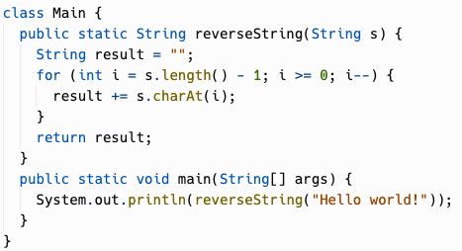
Reverse String Using for Loops

Slide 29
Nested Loops
Chapter 4.4

Slide 30
Rows and Columns
for (int i = 0; i < 5; i++) { for(int j = 0; j < 3; j++) { System.out.print(j); } System.out.println(); }
i = 0
j = 0
j = 1
j = 2
j = 0
j = 1
j = 2
The outer loop iterates through the rows
The inner loop iterates through the columns
The inner loop runs in its entirety on each iteration of the outer loop
i = 1
i = 2
j = 0
j = 1
j = 2
i = 3
j = 0
j = 1
j = 2
i = 4
j = 0
j = 1
j = 2

Slide 31
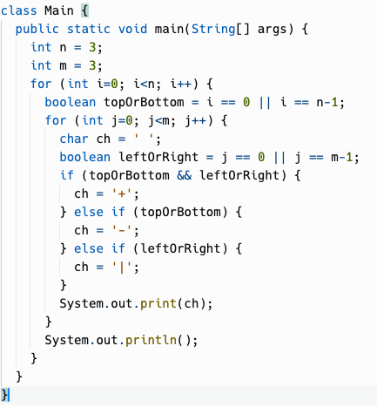
i | j | topOrBottom | leftOrRight | output
0 | 0 | true | true | +
0 | 1 | true | false | -
0 | 2 | true | true | +
1 | 0 | false | true | |
1 | 1 | false | false | (space)
1 | 2 | false | true | |
2 | 0 | true | true | +
2 | 1 | true | false | -
2 | 2 | true | true | +

Slide 32
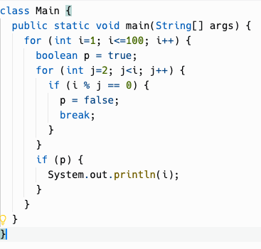
Tracing through primes
i | j | p (prime) | output
1 | 2 | true | 1
2 | 2 | true | 2
3 | 2 | true
3 | 3 | true | 3
4 | 2 | false
5 | 2 | true
5 | 3 | true
5 | 4 | true
5 | 5 | true | 5
Notes:
Still essentially a nested loop although one loop is in a method that is called
We'll trace through this loop in class

Slide 33
Runtime Analysis
Chapter 4.5
Notes:
OK, now we get to the actual subject for today, runtime analysis

Slide 34
What makes a good algorithm?
From CodeHS:
What makes a good algorithm?
Correctness
Easy to understand by someone else
Efficiency (run time and memory requirements)
Correctness refers to whether the algorithm solves the given problem.
Easy to understand can be a function of the complexity of the algorithm design, as well as how the code is laid out, use of appropriate variable names, and the use of comments.
Efficiency can be looked at in several ways, which we will explore in this section.

Slide 35
Runtime analysis
How long an algorithm takes to execute (run) is called its running time or runtime.
Runtime analysis is the process of understanding how an algorithm or complete program will perform when it is run.
It includes how long the program takes to run, as well as other factors like how much memory is consumed.

Slide 36
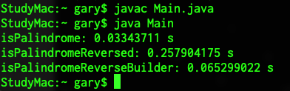
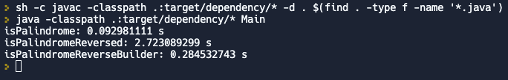
Timing Execution
System.currentTimeMillis() – milliseconds since "Unix Epoch" (January 1, 1970 00:00:00 UTC time zone). This is wall clock time… if you adjust the date/time on your computer, the value will change.
System.nanoTime() – nanoseconds since an arbitrary point in time (maybe since CPU booted). Independent of "wall clock" … it will continue increasing even if you futz with computer's date and time.
Different computers will give you different results, so timing benchmarks are only valid on the same hardware.
A lot of other stuff can be happening in other processes on a modern computer.
Different programming languages have different performance characteristics.
Even the same programming language may behave differently in different environments.

Slide 37
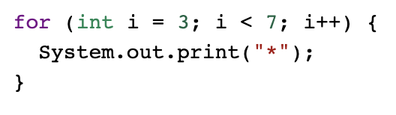
Statement Execution Count
Getting an absolute number of statements executed is tricky, and some of the things we may want to count are actually just expressions, not full statements.
Here, one way we might do it is to "point" it as follows:
int i = 3; counts as 1 point This part repeats for i=3, 4, 5, 6: i < 7 counts as 1 point System.out.print("*") counts as 1 point i++ counts as 1 point 1 + 3 * 4 = 13 "statements" total
There could be different counting methods here. On the AP exam, you'll probably be asked something more like: How many times is System.out.print called in this loop? That is, count how many times a specific statement is executed.

Slide 38


Loop Execution Count
You can use a trace table to figure out how many times a loop executes. But, you may be able to shortcut that just looking at it.
With a < condition, the number of iterations is (ending value - starting value) = 7 - 3 = 4 iterations.
When a <= is involved, the number of iterations is (ending value - starting value + 1) = 5 - 1 +1 = 5 iterations.
Both of these shortcuts assume the increment expression is just adding 1 to the counter.

Slide 39
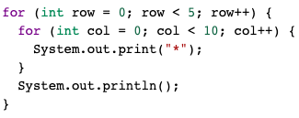
Loop Execution Count
For nested loops: The number of times a nested for loop body is executed is the number of times the outer loop runs multiplied by the number of times the inner loop runs (outer loop runs * inner loop runs).

Slide 40
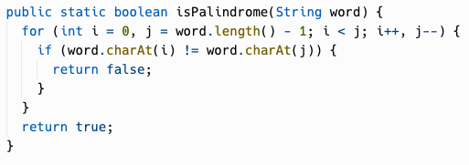
Best and worst case
Let's count the loop executions in this implementation of isPalindrome.
The loop execution count depends on the input.
The best case is a zero-length string. Next, a one-letter string. Next, the first and last letters do not match, which would be a loop execution count of 0 (but a statement execution count of 3, for the init expression, condition check, and return statement.)
The worst case is… if the string is really a palindrome, and we have to check every pair of characters! That would be word.length() / 2 loop executions.

Slide 41
Running time is proportional to…
Let N=100. (We use capitals for this a lot, for some reason.)
The outer loop executes N times.
The inner loop executes a variable number of times, but it is bounded by N.
The loop execution count isn't exactly N^2… it's less. But it is proportional to N^2; it will grow in concert with N^2, even if it doesn't follow an exact linear relationship with it.
The running time of this loop is proportional to N^2.
An algorithm that runs in N^2 time is said to run in quadratic time.
Notes:
Still essentially a nested loop although one loop is in a method that is called
We'll trace through this loop in class

Slide 42
Linear time
What is our isPalindrome implementation proportional to?
The loop execution count depends on the input, but it is bounded by the length of the input. If the input is length N, the loop will not execute more than N/2 times.
We can ignore the N/2 factor since we're talking about proportionality.
So, isPalindrome running time is proportional to N, where N is the length of the string input.
An algorithm with running time proportional to N is said to run in linear time.
What about the average case?

Slide 43
Computational Complexity
In computer science, the computational complexity or simply complexity of an algorithm is the amount of resources required to run it.
Time complexity is the amount of time that an algorithm takes to run, but in an abstract sense of how many operations need to be executed, not a quantity of seconds or milliseconds. The usual units of time (seconds, minutes etc.) are not used because they are too dependent on the choice of a specific computer and on the evolution of technology.
Space complexity is how much memory an algorithm consumes. A lot of our algorithms so far allocate no memory, or allocate one or two things. This is constant space complexity. Constant space complexity means that the amount of space that your algorithm uses is independent of the input parameters. Linear space complexity means you probably allocated an array of size N, or for, quadratic, N^2, etc.

Slide 44
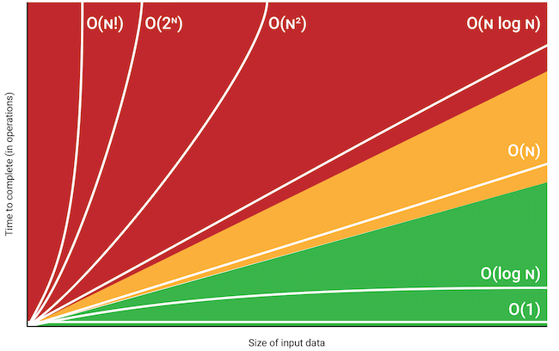
Big O notation
The time complexity and space complexity of algorithms are often expressed using "Big O notation" – the upper bound (maximum) running time or memory usage.
O(1) = Constant time (unconnected to length of input)
O(N) = Linear time
O(N^2) = Quadratic time
Other common ones: O(N^3), O(log N), O(N log N), O(N!), O(2^{N})

Slide 45
Practice!

Slide 46
Roll-up / Aggregation
Mail Merge (Templating)
Works of Shakespeare
"Personalized" letters
ThankYouMachine
# of words, # of lines
total and per work
Template with
placeholders
Dear $NAME,
$GREETING!

